Slide 1
Student Information System (SIS) Capstone project
Anupama Karumudi
Veekija Thirumalai

Slide 2
Agenda
Overview - SIS
Why SIS?
Technology details
SIS – Features
Administrator Modules
Teacher Modules
Student Modules
Public User Modules

Slide 3
Overview – SIS
SIS is

Slide 4
Why SIS?
SIS is

Slide 5
Technology Details
JSF & XHTML
XHTML facelets with JSF are used for page design, presentation and common form data validations.
Java Beans
Managed Java beans are used within JSF pages for data binding.
JPA
Java Persistence API (JPA) is used to simplify persisting objects to the database.
Rich faces
Richfaces is used within JSF facelet for calendar controls and rich text editor.
Web Filters
Used Java Servlet’s Web Filter with URL patterns to protect secured pages.
CSS
JSF resources are used (CSS) to maintaining consistency throughout the site
Derby database
Derby database is used for storing and retrieving the quiz data and user profiles.

Slide 6
SIS Features
SIS is

Slide 7
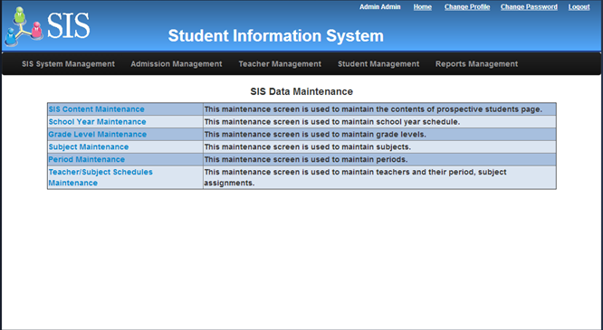
Administrator Modules
SIS System Management
Maintain to support school system data.

Slide 8
Administrator Modules – contd…
Admission Management
Edits submitted online application.
Creates new admission workflow.
Manages admission workflow process into various stages including:
Initial Review
Interview Requested
Approved
Rejected.

Slide 9
Teacher Modules
SIS is

Slide 10
Student/Parent Modules
SIS is

Slide 11
Public User Modules
SIS is

Slide 12
Thank You

